Slide 1
Required to change settings. According to my needs. Mention In Below Image.
Super Admin Define in the setting Which Role Id can Add, Edit, Update, Suspend any user or In Any Feature available in Dashboard of the Admin or any other user.
Role Id -1 Assume as Super Admin. Any Other role Id greater theen 1 Assume as Admin. If his Sub Id is-0(Null) and Staff Id is-0(Null) this will Create Database record only when Super Admin Add Any User.
Super Admin Can See All Data Create By Any User in Any Role Id, Sub Role ID or Any Staff Id.

Slide 2
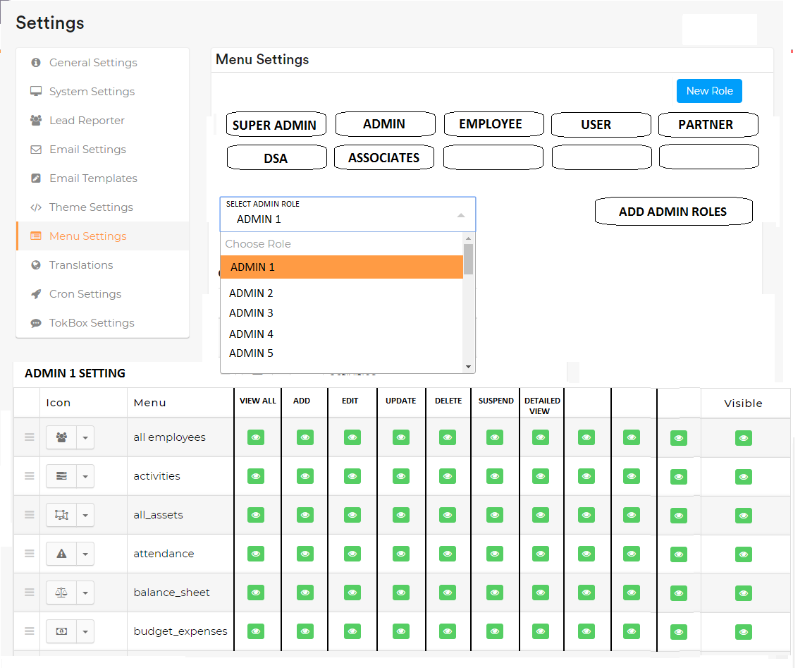

Slide 3
You have to define any user to in 3 types of role. 1-Role Id
Role Id(Admin)-1 Assume as Super Admin. Any Other role Id greater theen 1 Assume as Admin. If his Sub Id is-0(Null) and Staff Id is-0(Null) this will Create Database record only when Super Admin Add Any User.
Admin Define in the setting Which sub coordinates of Admin can Add, Edit, Update, Suspend any user or In Any Feature available in Dashboard of the Admin.
Role Id User Only see data created by Any other sub coordinates & Staff Id user under the same Role ID& Sub Role ID & Staff Id.
In case of Salary or incentives everyone see only data related to him self only

Slide 4
You have to define any user to in 3 types of role. 2-Sub Role Id
Sub Role Id-When Any Admin Add Any user this will assume as sub coordinates of Admin. Sub coordinates Id will Assume as Role Id-In Which Role Id Admin going to add Any user. Sub Id-1(Greater then records available in database) and Staff Id is-0(Null) this will Create Database record only when Admin Add Any User.
sub coordinates of Admin Define in the setting Which User can Add, Edit, Update, any Data & Feature available in Dashboard of the sub coordinates(Sub Role ID).
Sub Role Id User Only see data created by Any other Staff Id user under the same Sub Role ID & Staff Id.
In case of Salary or incentives everyone see only data related to him self only

Slide 5
You have to define any user to in 3 types of role. 3-Staff Id
Staff Id-When Any Sub coordinates Admin Add Any user this will assume as Staff of Admin Sub Coordinators. Sub coordinates Id will Assume as Role Id-Same As Sub Coordinate ID Sub Id- Same as Sub Coordinate ID who added User and Staff Id is-1(Greater then records available in database) this will Create Database record only when Sub Coordinate Admin Add Any User. He cannot Add Any Other Users.
▪ Staff Id User Only see data created by Any other Staff Id user under the same role & Sub Role Id.
▪ In case of Salary or incentives everyone see only data related to him self only

Slide 6
Rules Of Role Id, Sub Role Id, Staff Id
No one Small Role ID-User can Add, Edit, Update or See Any Data of the Greater role Id. Only when he/she see when his add user grant Add, Edit Update Permissions in the settings.
This Role Id, Sub Role Id, Staff Id will Mark in Every data Add, Edit, update in the database. Like Invoice Application , Project, Task, Payments To analysis of data flow of the database. Also Provide Incentives & rewards according to work of the users.

Slide 7
Dashboards
Super Admin Dashboard Will be for all Users. Like Admin, DSA, Associate, Partners But with According role Id to access data define in Roles Types. Above in Slide-3,4,5,6.
Dsa & Associate will see Exact same dashboard but in Partners some customization required like they cannot add Application. They will only see the application and update on status or add task in the application only.

Slide 8
Dashboard Menu
Home-User Redirect on dashboard
Employee-Staff Id will work there.
Services-User can go And Add new Application on the services provides by Super Admin In Service Settings. In this menu Partners not able to add application they will create a service if super admin grant permission to do this.
Applications- User can Check Application status in this menu.
Report-Admin report modal work but user can only see statistics & data of revenue only created by in his/her role Id/Sub Role Id Only.

Slide 9
Modals Required to Add
DSA Registration & Dashboard Modal:-
DSA Can Apply for membership on the from website of the company by Fill Some Forms Required Approval of the same Role ID As DSA Role Id Admin. After the Approval Or Reject OR Comment on Application of DSA Membership By the admin. DSA Applicant received notification on His/her registered Email Id About Admin Action Approval Or Reject Or Remark on Application.
If Application
Rejected- Admin Required to add Remark of rejection of application. This remark send to DSA Applicant Email ID.
Approve- DSA Received Approve Email And he/she can login on the portal. Do work as DSA Dashboard & Menu design for DSA.
Remark- Will Mark by admin if any other document or any other clarification required for application processin.

Slide 10
Modals Required to Add
Associate Registration & Dashboard Modal:-
Associate Can Be add by same Role ID Admin As Associate Role ID.
He/She Also Can Add Associate If Admin Grant permission to add Associate to Any Associate. Add, Edit, Update, Profile view, Suspend permission will same work Admin has been grant at the tome of adding the Associate.
Same Dashboard For DSA & Associates Required.

Slide 11
Modals Required to Add
Partners Registration & Dashboard Modal:-
Partners Can Be add by same Role ID Admin As Partners Role ID.
Same as DSA Dashboard will show. But Role ID is different which is same partners Admin Role Id. But Partners can not Add applications. As Mention in slide 8.

Slide 12
Service Buyer
User Can go on front services web page and if he/she want to register buy or apply any services of website he/she need to login or Sign Up himself in the system.
After registration he/she need to verify his Email to buy or apply for services

Slide 13
Service Buyer Dashboard
Service Buyer Menu
Dashboard
Products
Consultancy
Credit Card
Personal Loan
Any other menu will be add when Super Admin Add Any services in Service Setting
Support
FAQs
Submit a Query
Contact Us
Dashboard Look in below

Slide 14
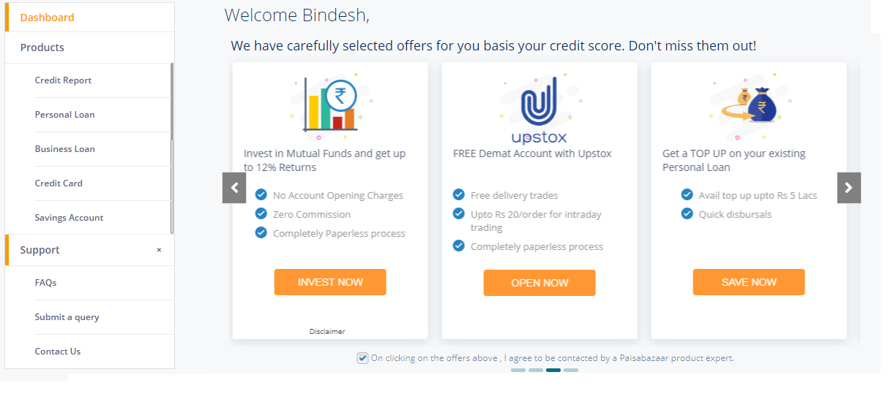

Slide 15
Required to build Front Web Pages
Please review my old website to understand my requirement mention link below.
http://www.creditupchar.com/

Slide 16
Pin Code
Required to build Pin code API According to my data needs. I will provide you all data of pin code in excel format.

